Slide 1
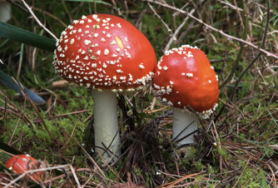

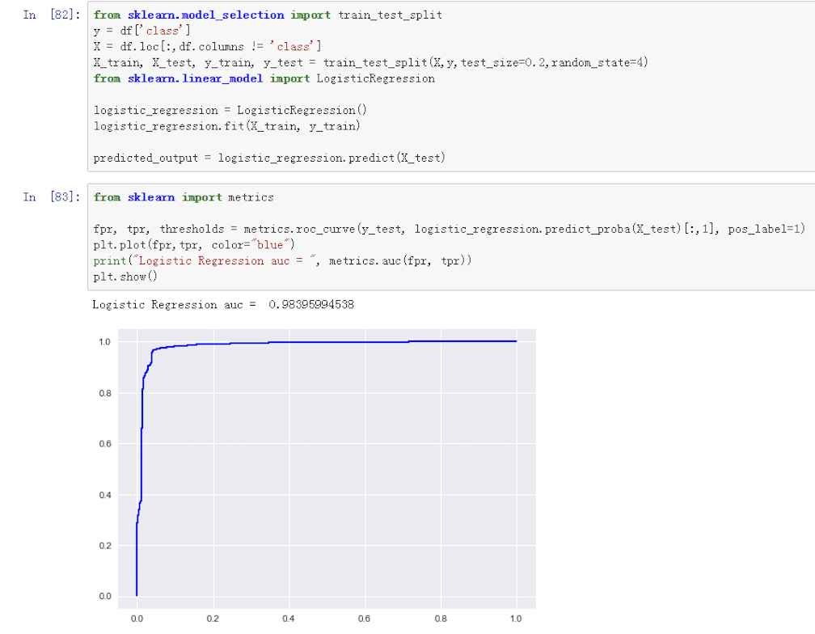
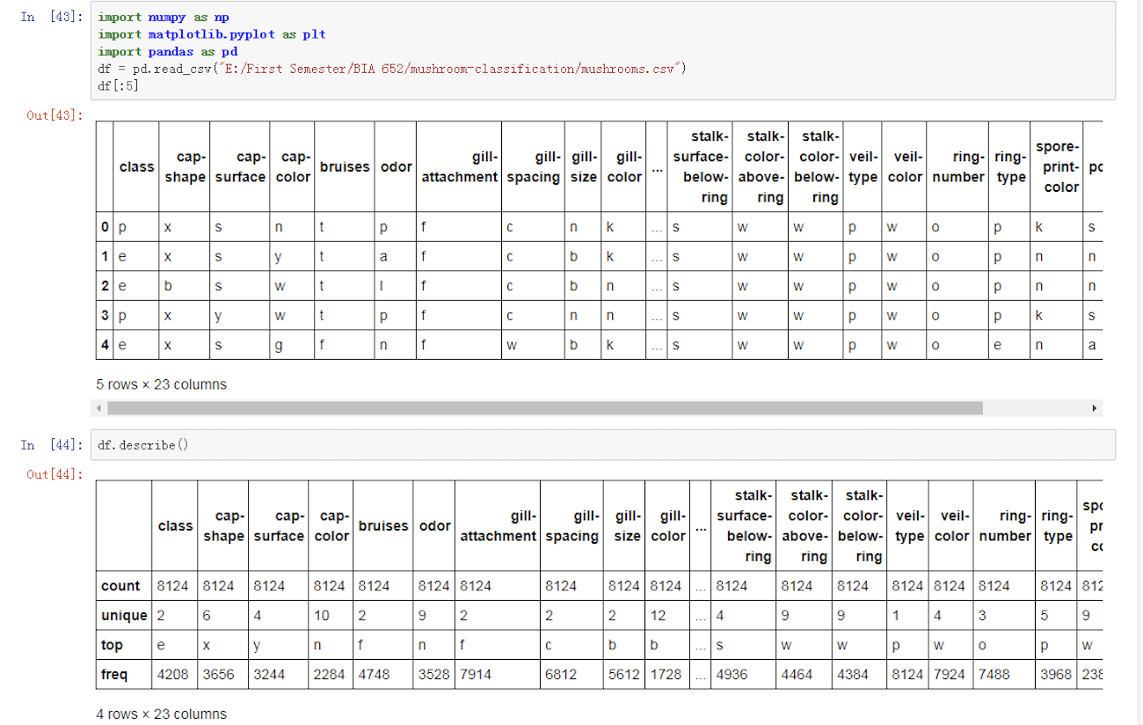
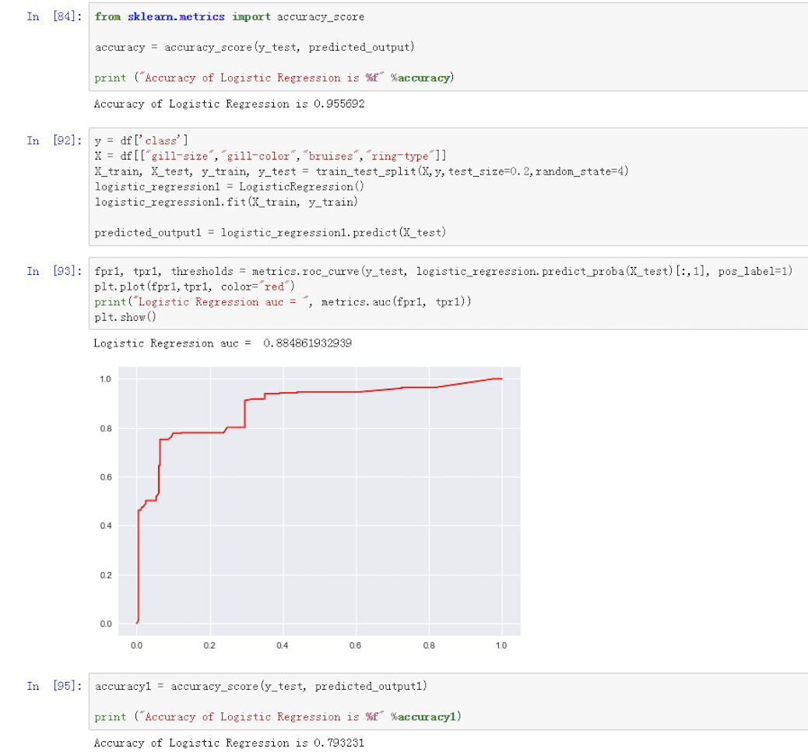
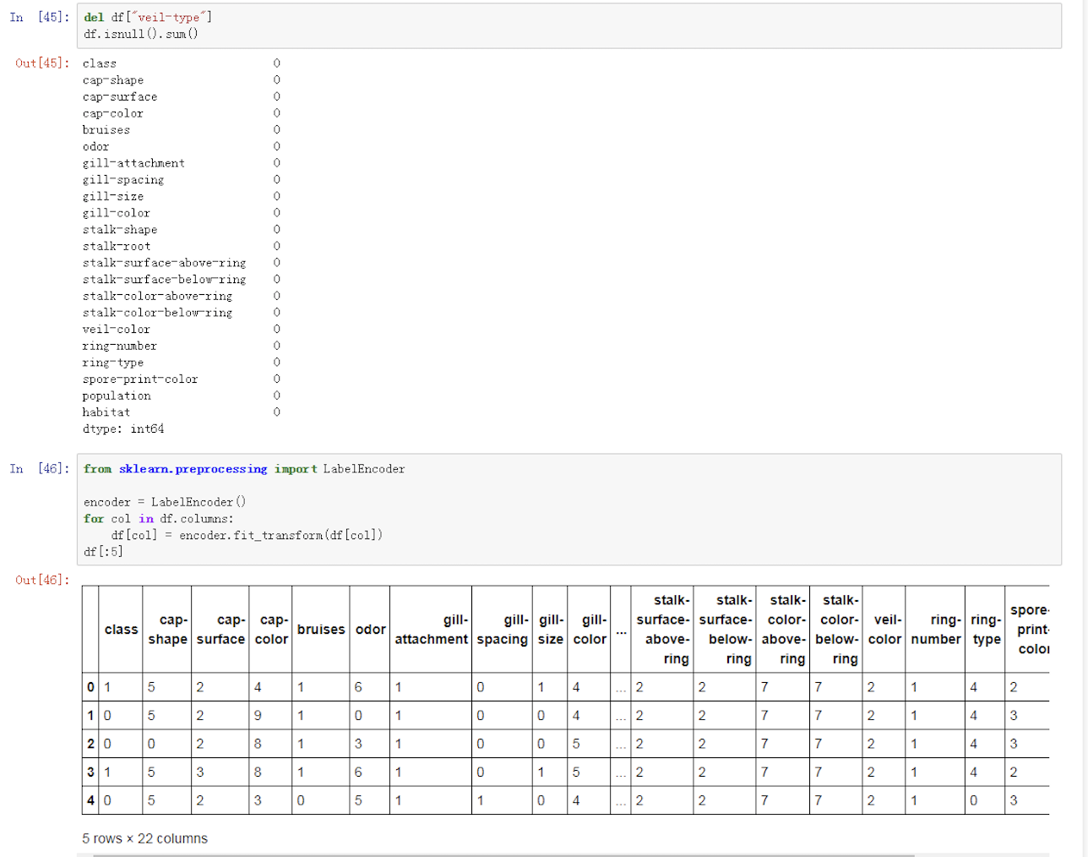
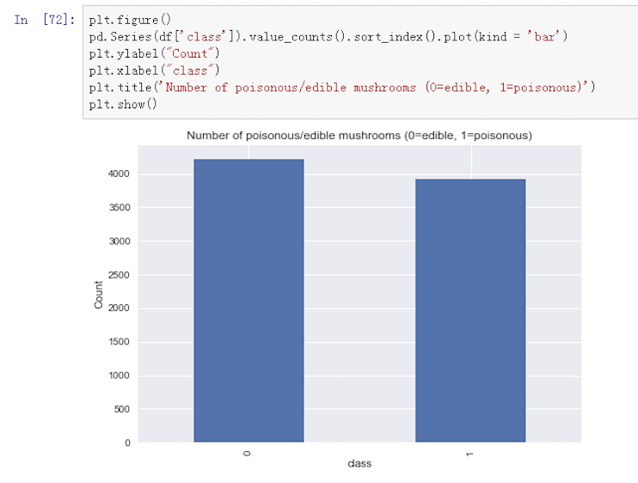
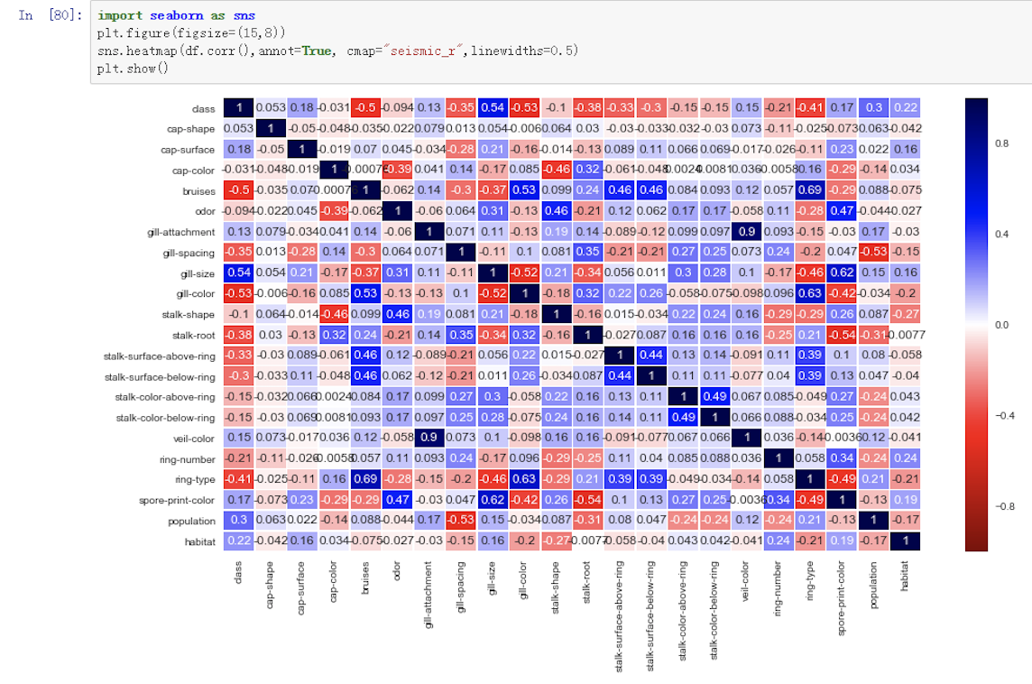
Wild Mushroom Identification Instructor: Yifan Hu Xiang Yang, Ruiwen Shi, Shikuan Gao, Haoran Du
Business Intelligence & Analytics
Introduction
Mushroom, obtainable and common out in the field, is a good source of protein, vitamin and several minerals. However, only some of them are edible while the others are poisonous even fatal, which makes identifying them critical. Our simulation tries to unravel a relation between certain physical features of a mushroom and its poisonousness.
Using Logistic Regression through Python to create a model. Then find the most related features to identify whether a mushroom is poisonous or not.
Modeling
Data Understanding
We get our raw data from Kaggle, it is a dataset with 23 species of gilled mushrooms, in total there are over 8000 variables and 23 attributes. Each attribute may have somehow influences on the outcome of whether the single types of mushroom is edible or poisonous.
Data Preparation
To prepare our dataset ready to be analyzed and modeled, we first check our data by null check, the data should have no null values, otherwise, there will be problems in building the model later. Second, since the dataset has string values, we need to convert all the unique values into integers then label encoding is performed on the data. Then, we use data balance to make sure our data prediction will be unbiased towards the more frequent class. Last, we split the data into train data and test data according to the ratio of 8 to 2 to build and test the model.
Results
The AUC of our model that uses all the mushroom features is 0.984 and accuracy of that is 0.956, which is pretty good and means our model can accurately classify whether a mushroom is edible or poisonous. Because the high accuracy of the logistic regression model, there is little improvement space for modeling. Thus, we do not use more other algorithms to build different models and compare accuracy. But, in general, it is difficult to obtain all the 22 features of mushroom. So, we only use the four features that are most correlated to the class and build another model. This time, the AUC and accuracy of the model drop slightly, 0.885 and 0.793, respectively, which shows that the model is good enough for classification.

